Slide 1
Web Programming 1
Worksheet 5
Improving movie app
Input/Output/EventEmitters

Slide 2
Our top level <app-component> contains all of the other child components
<app-component>
1
<add-movie>
2
3
<list-movies>
<movie-detail>

Slide 3
App-Component
ˇ
Parent
@Input
@Output
List-movie
Movie-details
Children

Slide 4
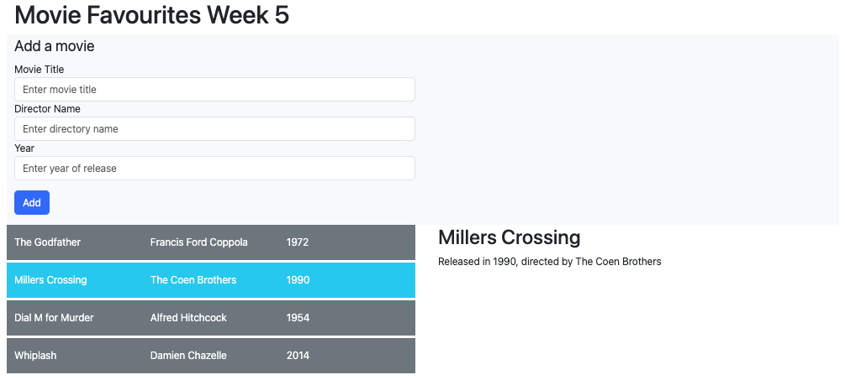
What our Week 5 app will look like

Slide 5
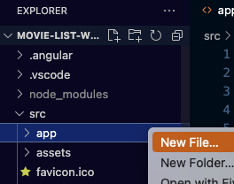
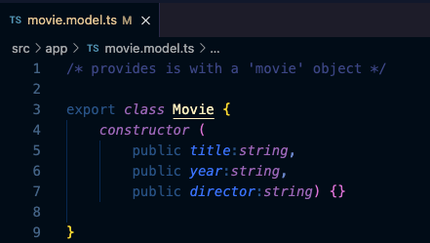
1.Create movie model
In VS code create file called movie.model.ts – this will hold a new data model for our movies
Add the following code

Slide 6
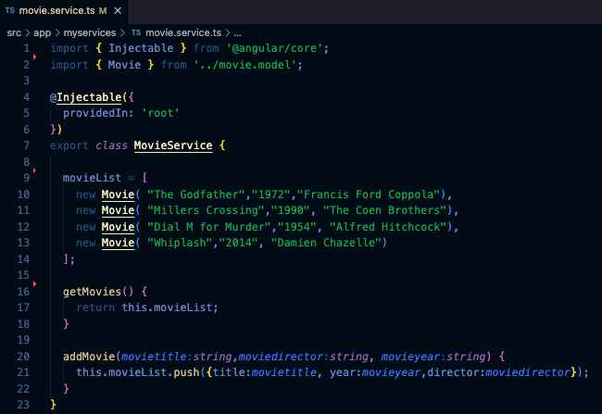
2. Adjust our movie.service.ts
1. Import Movie model so we can use
it in movie.service
2. MovieList is now populated
using new New Movie()
3. addMovie now pushed with using new Movie
Your code is running as normal after making
these changes – should be no visual change

Slide 7
3. list-movies.component.ts
We want to support user interaction in our app.
The user will click on a movie on the list to view more information about the movie
In list-movies component we do the following:
We import Movie class from movie.model
1. We import Movie class from movie.model

Slide 8
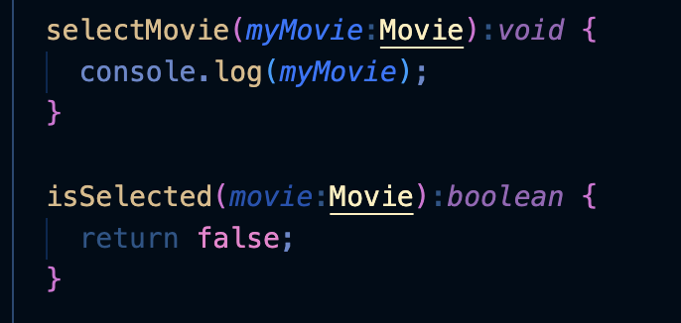
4.list-movies.component.ts
Create a couple of placeholder methods
selectMovie() – this will contain code that eventually sets the selected movie
isSelected() – this will eventually set a selected colour on movie user choses

Slide 9
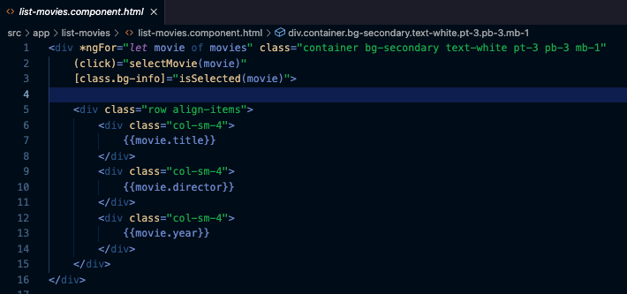
5. list-movies.component.html
(click)=‘selectMovie(movie)' describes what we
want to do when this element is clicked.
click is a built-in event that is triggered when the host
element is clicked on.
In this case, we want to call the function selectMovie() in
list-movies-component.ts whenever this element is clicked on

Slide 10
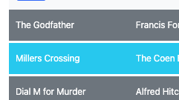
5a. list-movies.component.html
[class.bg-info]="isSelected(movie)"
Angular allows us to set classes conditionally on an element using this syntax
This syntax says “add the CSS class bg-info if isSelected(movie) returns true:
This is a really handy way for us to mark the currently selected movie

Slide 11

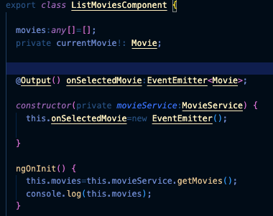
6. list-movies.component.ts
1. Add EventEmitter, Output
2. Import Movie
3. Declare currentMovie
4. Add @Output
5. Modify constructor()
Add this from last week – populates the movies array

Slide 12
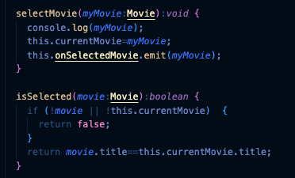
7. list-movies.component.ts
Modify these method stubs we created earlier
selectMovie()
Set this.currentMovie to the movie that was passed in.
Emit the movie that was clicked on our output
isSelected()
Accepts a movie and returns true if movie’s title matches the currentmovie’s title.
It returns false otherwise.

Slide 13
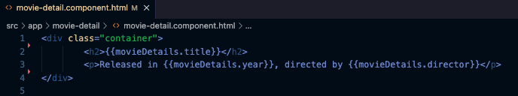
8. Create Movie detail child component
The movie details child component will display the full details of the movie to us.
From Angular CLI type and within your app directory
ng generate component movie-detail
Add this code to the movie-detail
template (movie-detail.component.html

Slide 14
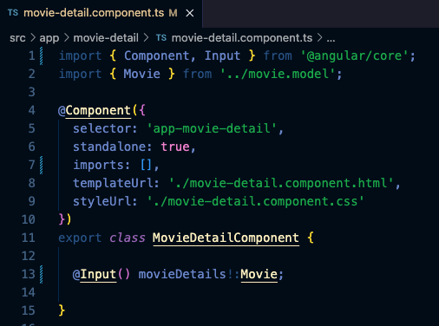
9. movie-detail.component.ts
1. Add Input
2. Import Movie class
3. Ad @Input decorator

Slide 15
The final steps..
Now we want to do the final binding of emitted output movie data from movie-list to feed the input of movie-detail
Clicking on a movie in our movie list emits an event through @Output
App Component uses event binding to catch this emitted event and fire and event with event data as parameters
This event is passed back to App Component
This is then bound to our movie detail component via @Input
The movie detail is displayed

Slide 16
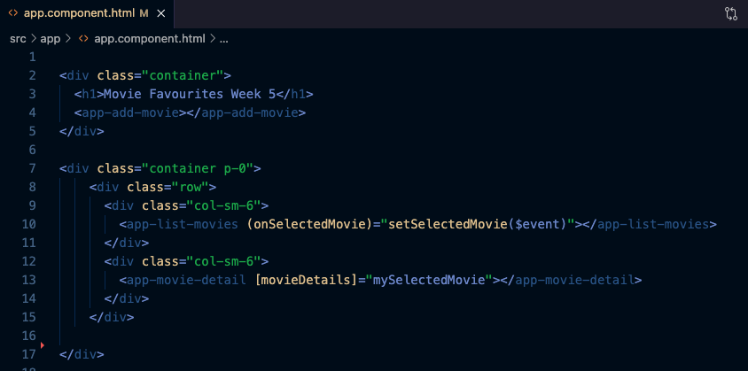
10. app.component.html
1. With event binding, the emitted event OnSelectedMovie() from app-list-movies
And fires setSelectedMovie() in app.component.ts – movie details are passed in $event
The mySelectedMovie variable is then set to the data sent in the original click event
of the MoviesList Component and then movieDetails is then set via the @Input decorator
In movie-detail-component.ts

Slide 17
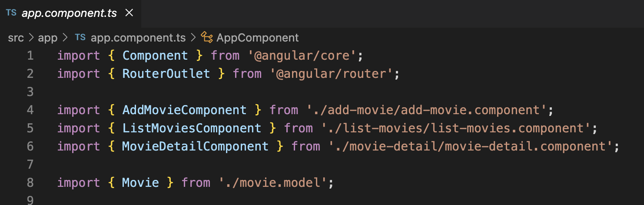
11. app.component.ts – imports
Make sure your Add, List and MovieDetail are also added to the @component decorator..

Slide 18
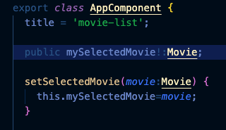
12. app.component.ts – final step

Slide 19
11. app.component.ts – final step

Slide 20
Upload your work
Add your name and student id
Take a screenshot where you have selected a movie and are displaying the movie-detail component
Add screenshot to your repo – it should be in root directory, not in src/app
Download the repo zip file
Upload repo to moodle

